Slide 1
The LACE Model: Tying the Pieces Together?
Ann Marie Felauer, MS, CRNP-AC/PC
University of Maryland
School of Nursing

Slide 2
Objectives
Review the history of the nurse practitioner
Identify effects of APRN Consensus Model on the role of the APRN
Discuss implications for personal practice and models of care

Slide 3
Historical Perspective
October 2014: 180,233 NPs practicing in U.S. 240+ DNP programs
1965: 1st NP program
1973: 65 NP programs NAPNAP
2001: Univ of KY DNP program
2008: APRN Consensus LACE Model
1979: 1st nursing doctorate, 15,000 NPs
2004: AACN Position Statement on Practice Doctorate
2010: IOM Report results “Future of Nursing”
2015: Full implementation of APRN Consensus due

Slide 4
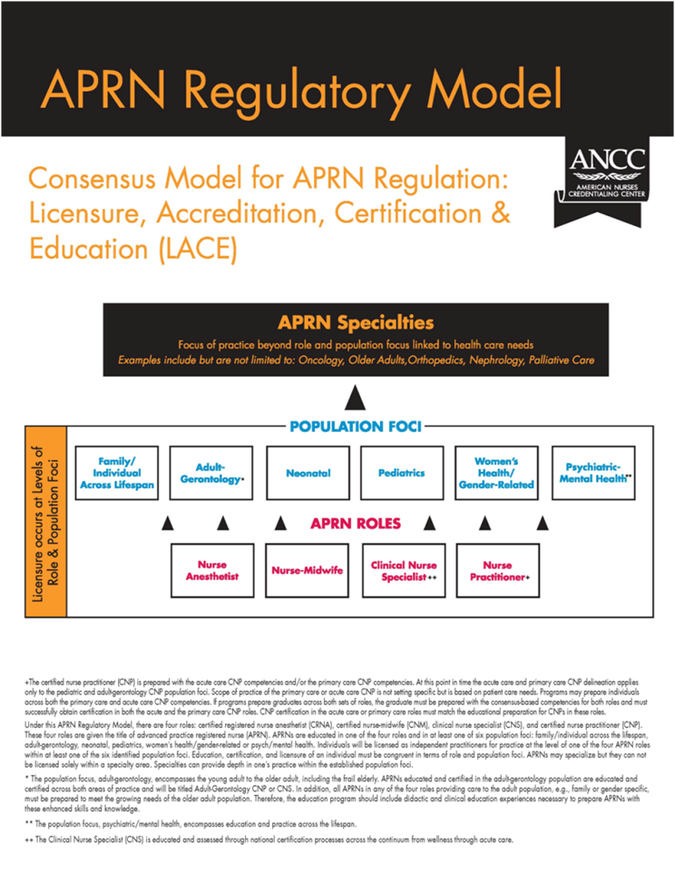
LACE Model

Slide 5
Effects and Implications
Education
State boards of nursing/Prescriptive Authority
Practice

Slide 6
Education
2015 Deadline
MSN to DNP programs
Certification exams
Notes:
AG-exam no longer adult or gero exam….

Slide 7
Board of Nursing
https://www.ncsbn.org/736.htm
State-specific legislation
Maryland
Virginia
Delaware
Pennsylvania
Notes:
Review details about states

Slide 8
Practice
Models of NP practice
NP as a Primary care provider
Physician/NP
Resident-Fellow/NP
What else?
Notes:
Medical home
Sedation teams

Slide 9
Where do we go from here

Slide 10
References

